Slide 1
Artificial Neural Network-Based Robotic Control
Master’s Thesis
Justin Ng
June 8, 2018
Committee Chair Committee Member Committee Member | Andrew Danowitz, Ph.D. Xiao-Hua Yu, Ph.D. Fred W. DePiero, Ph.D.

Slide 2
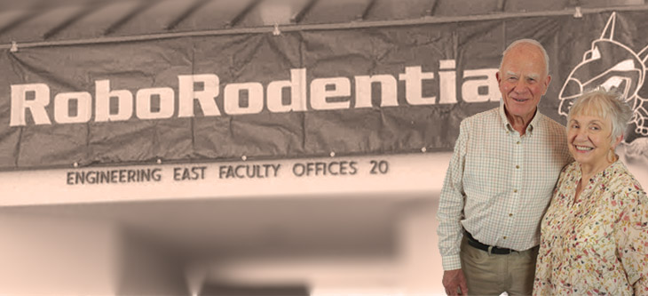
Project Motivation – Cal Poly Roborodentia
Annual intramural robotics competition.
Fully autonomous robots.
Different game every year.
Source: http://roborodentia.calpoly.edu/
Notes:
The original motivation for the project is Roborodentia.
Annual intramural robotics competition.
Takes place in Spring Open House.
Fully autonomous robots compete in a task such as shooting golf balls into goal, moving rings around.
Changes every year.

Slide 3
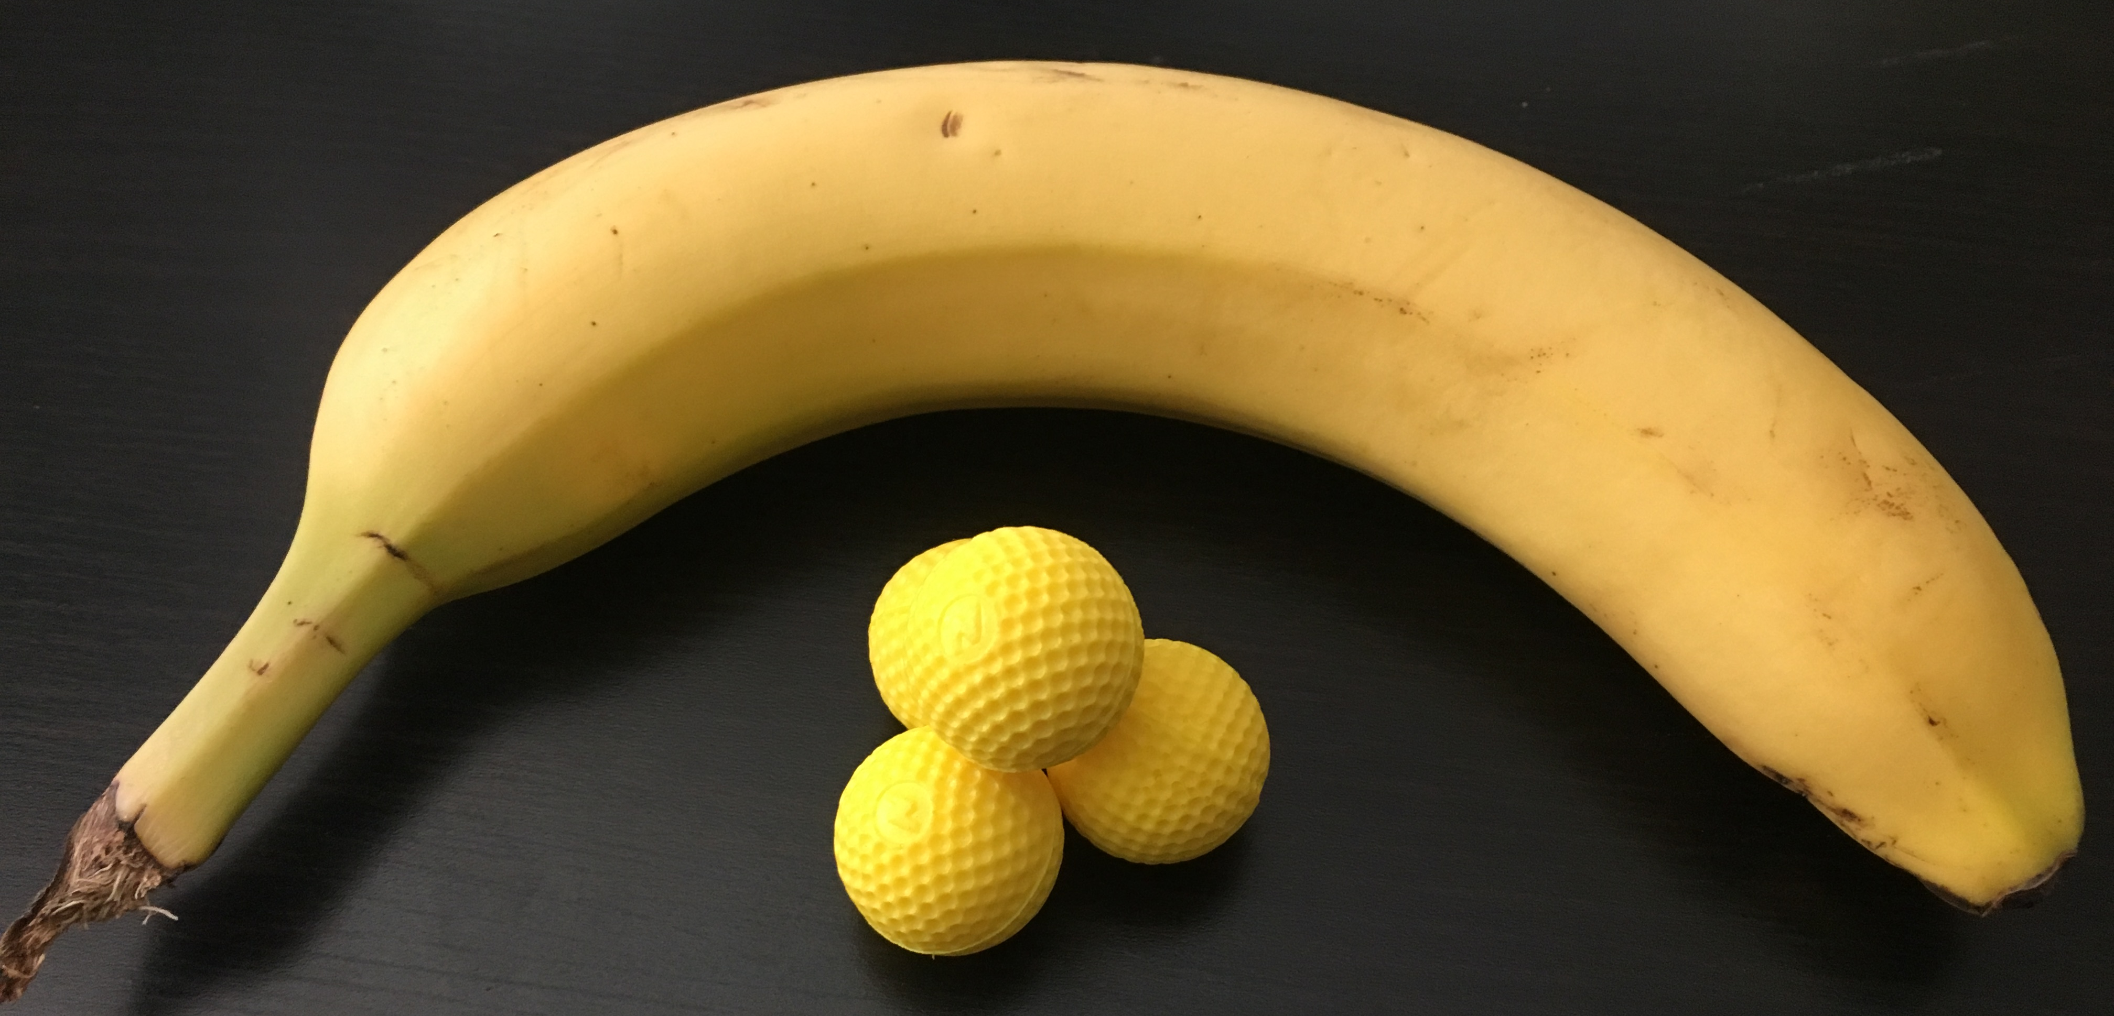
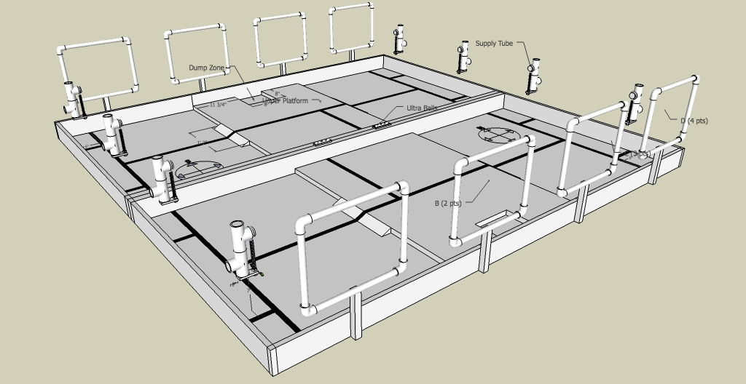
2018 Cal Poly Roborodentia
Robots obtain Nerf Rival balls from supply tubes.
Shoot balls into nets to score points.
Source: http://roborodentia.calpoly.edu/
Notes:
The 2018 game involves…
On paper, it’s a fairly simple task but requires fair amount of mechanical, electrical, and programming coordination to produce a robot that will do it autonomously.
Usually teams include three people to divide up work.
Wanted a challenge. Decided I wanted to build a high quality robot with a little something extra that no one has done before.
So here it is…

Slide 4
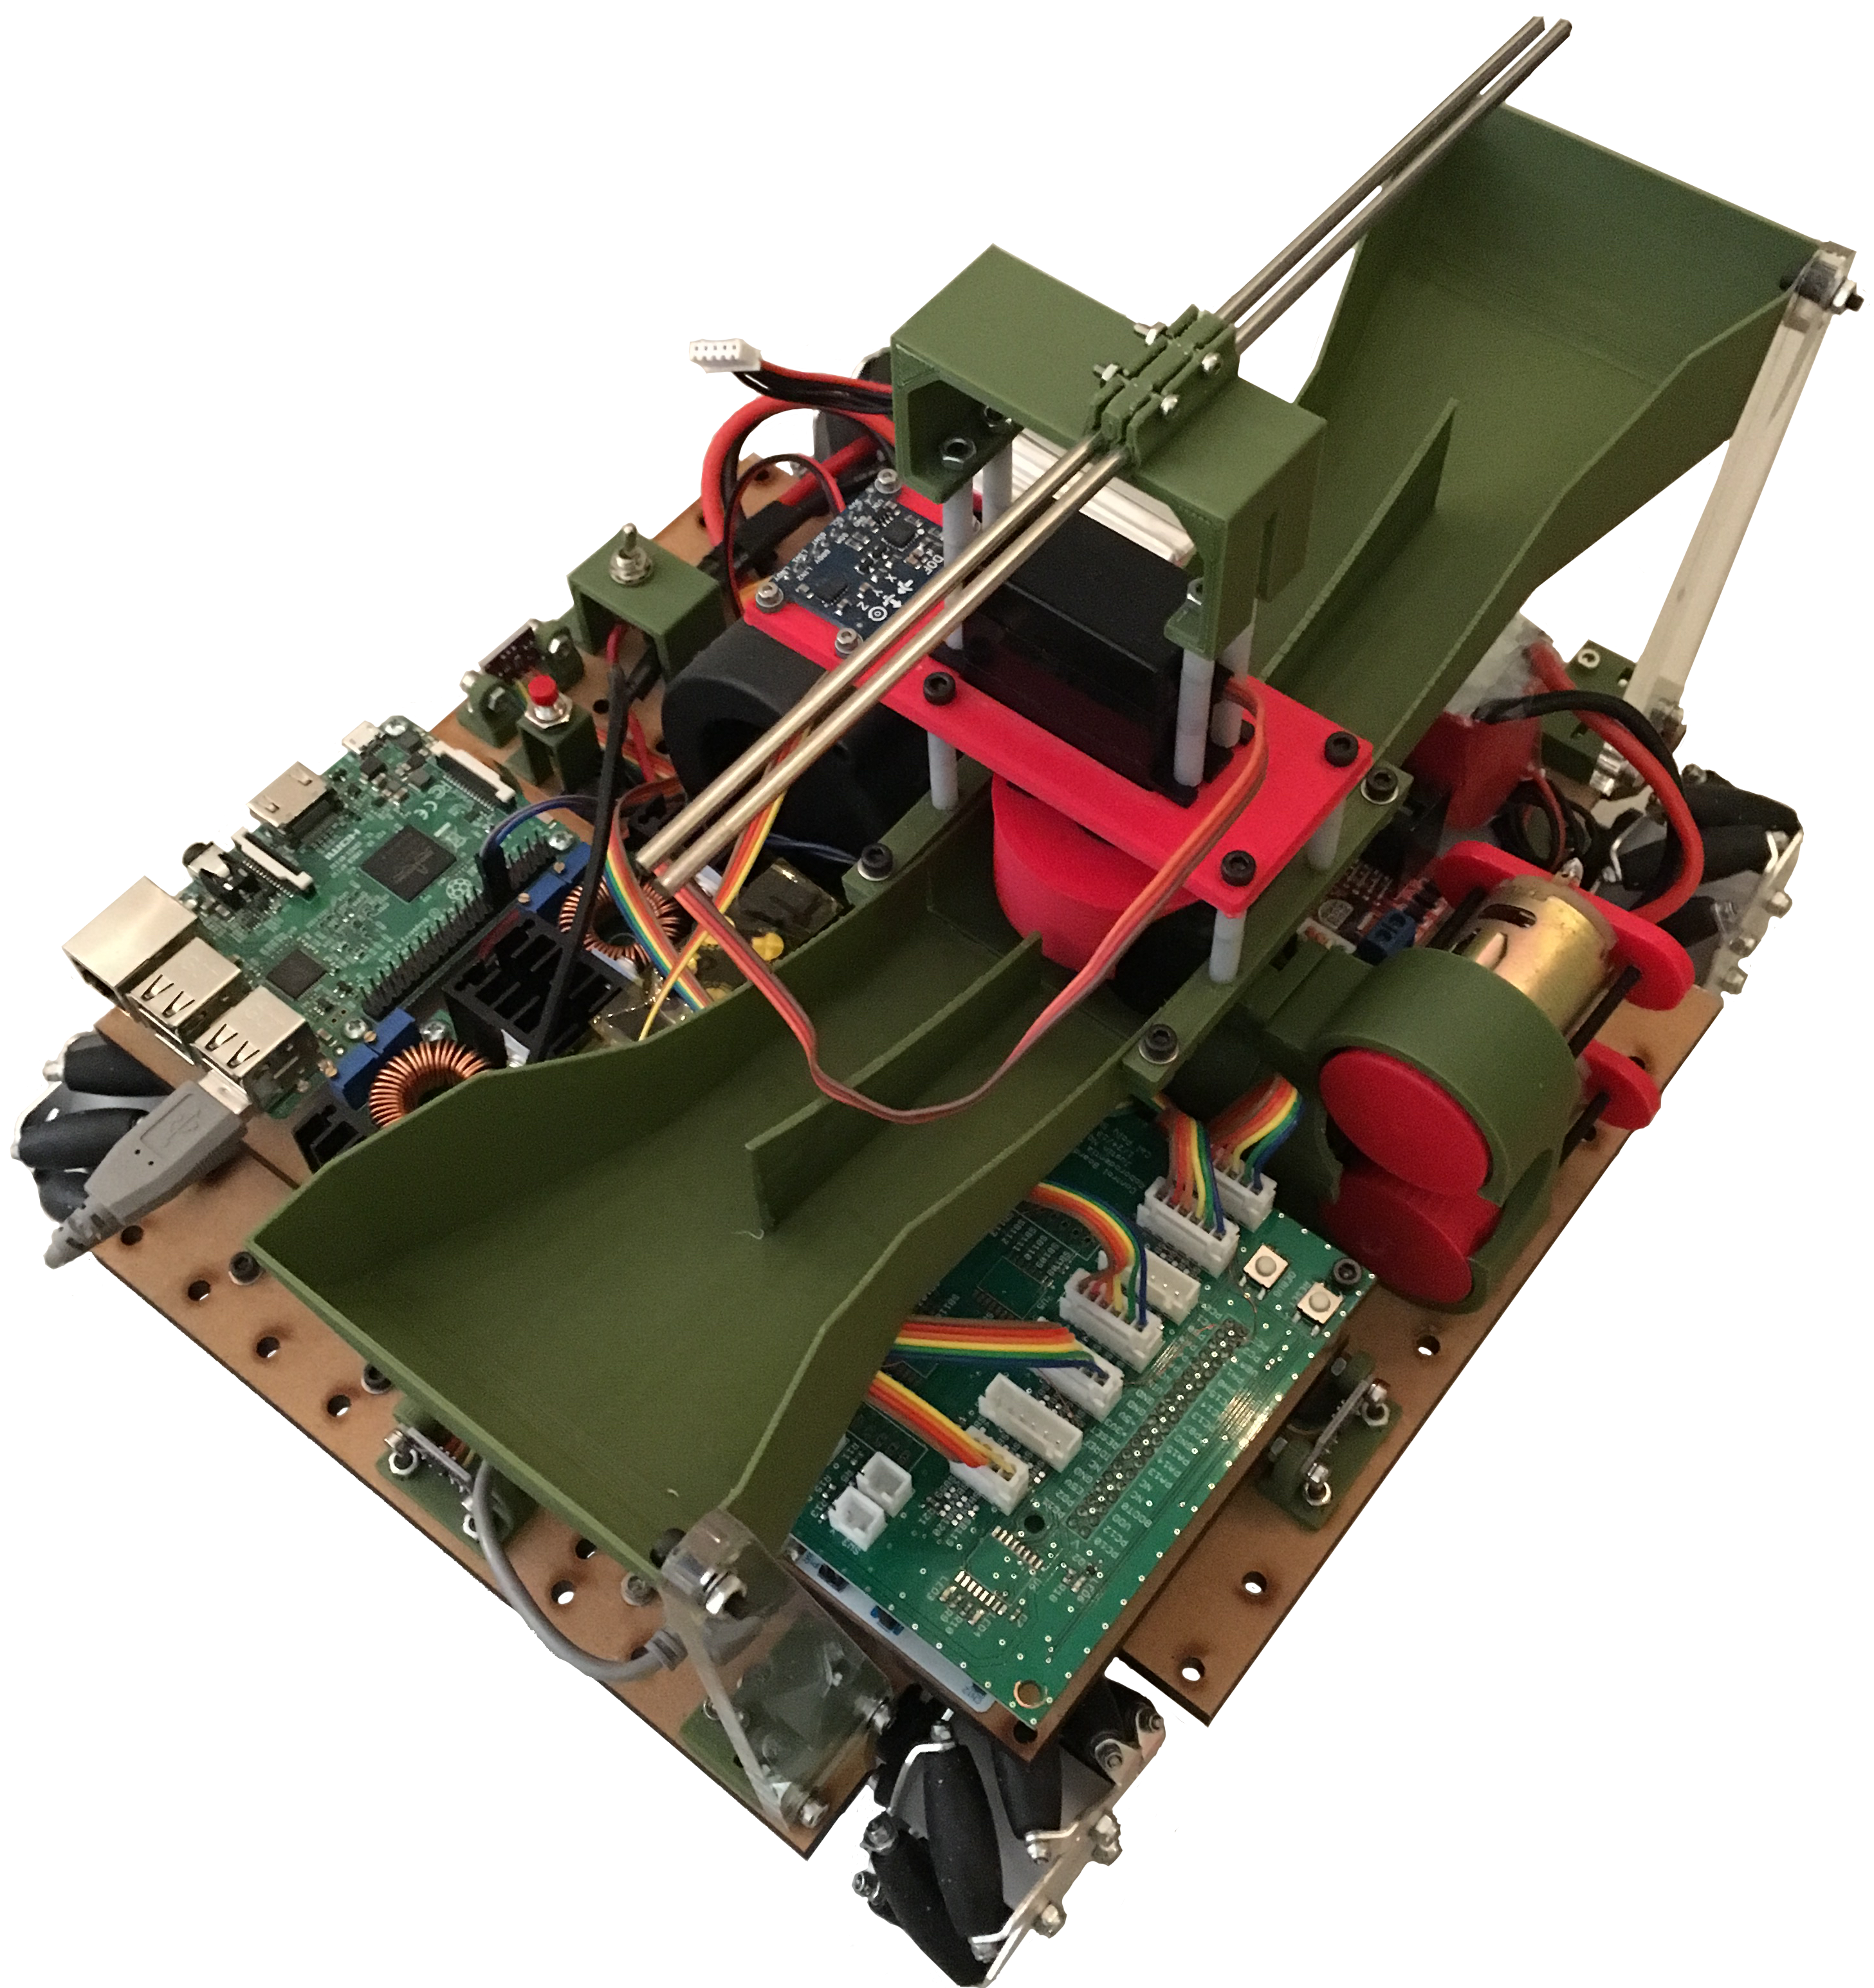
2018 Entry
Built from scratch.
394 individual parts.
Custom PCB for connecting electronics to microcontroller.
Notes:
In red and green, many custom designed 3d printed parts.
Hopper on top collects balls, shooter launches them into nets.
Uses mecanum wheels
Custom PCB for connecting sensors, motors drivers to MCU.

Slide 5
Problem Statement
Implement a reinforcement learning algorithm to control the robot’s position and orientation in the field with continuous state and action spaces.
Notes:
Robot uses four motors which take continuous voltages to move around in a continuous environment.
Challenge to implement RL to control position and orientation with continuous state and action spaces.
Most RL algorithms have operated in discrete or discretized environments. E.g. AlphaGo.
Within last three years, great breakthroughs in continuous RL problems, namely DDPG.
Why is continuous state/action important?
Why is this whole thing important?

Slide 6
Outline
Introduction/Motivation
Background
Solution
Implementation
Results
Future work and conclusions

Slide 7
What is Reinforcement Learning (RL)?
Subset of machine learning.
Solves control and action selection problems.
Source: http://www.smartcitymemphis.com/2018/04/the-future-is-about-making-better-choices-now/
Notes:
Concerned with how actors should choose actions in an environment to get the most reward or goodness.
For example, in a game of chess, what move should I make to win?

Slide 8
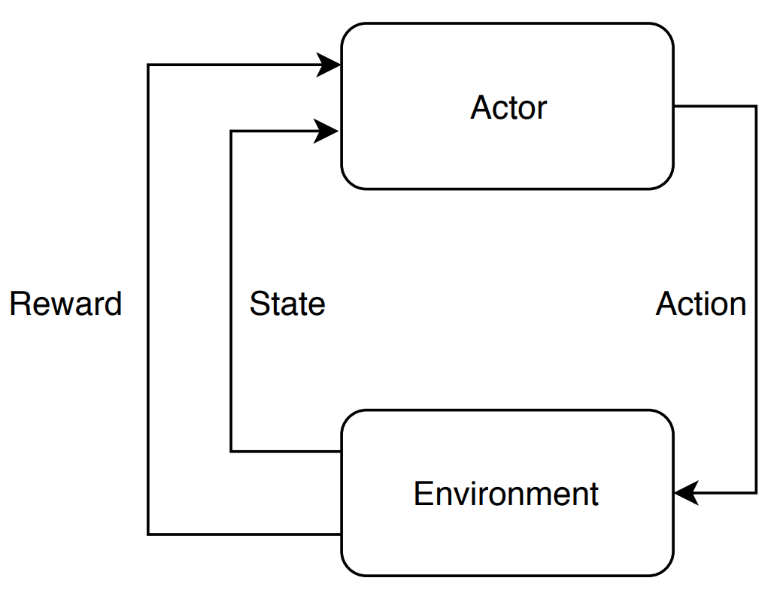
Reinforcement Learning Elements
Environment
Actor/agent
Reward/return (R, r)
Policy (π)
Value function (V, Q)
Sometimes a model
Notes:
Environment The various states and associated rewards through which the actor navigates.
Actor/Agent Chooses actions based on a policy.
Reward/return (r) A number emitted by the environment denoting ”goodness” of the state
Policy (π) The strategy by which the actor chooses its actions, e.g. random, exploratory, greedy.
Value (V) The expected long-term reward of a state. For example playing a game of checkers and you have four kings while the opponent has four pawns.
Model allowing prediction of the next state from the current state and action

Slide 9
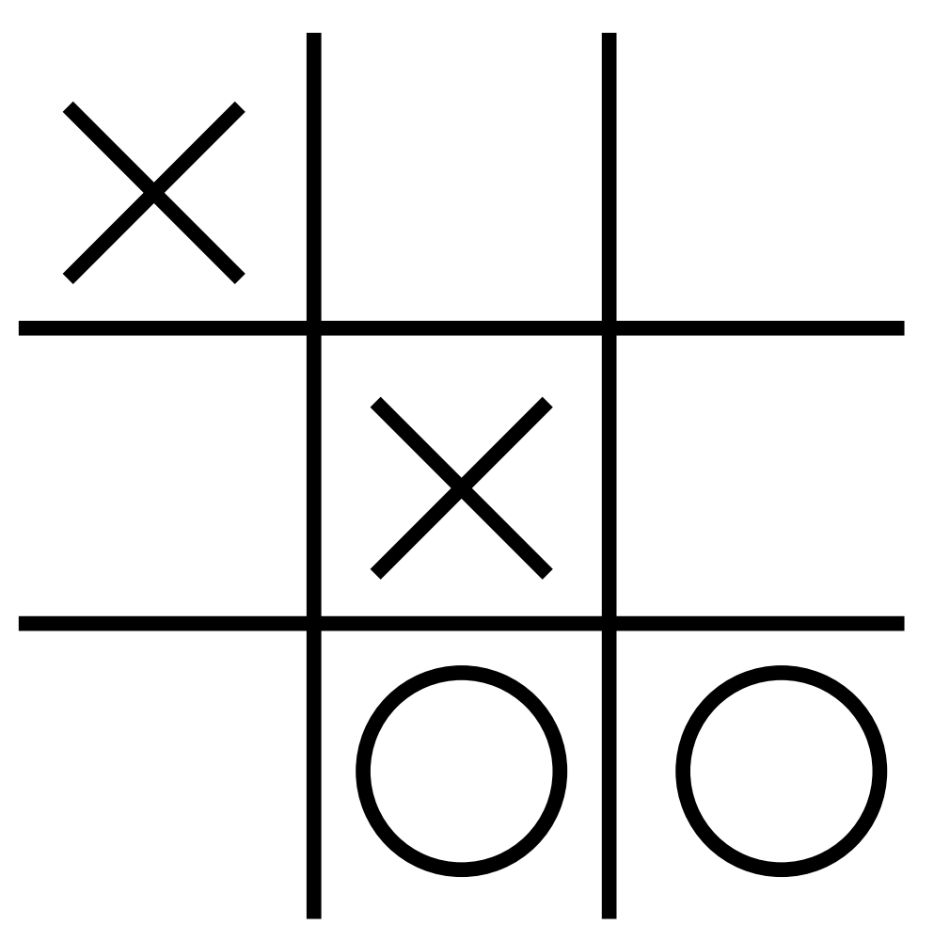
Reinforcement Learning Elements – Tic Tac Toe Example
Environment
Actor
Action (a_{k})
Reward (r_{k})
State (s_{k})
Transition [s_{k}, a_{k}, r_{k}, s_{k+1}]
Notes:
Reward: winning or losing
About 20,000 states

Slide 10
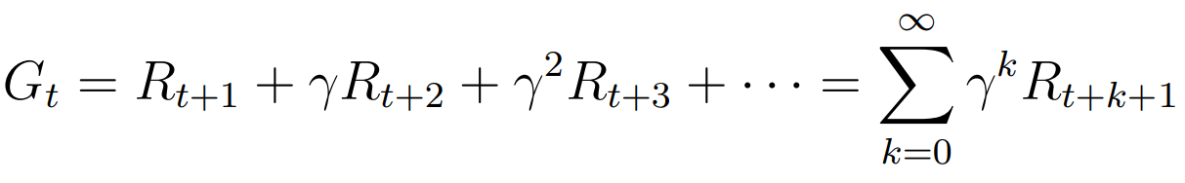
Long-term Discounted Reward G_{t}
Calculated as sum of all future rewards weighted by a discount factor γ.
Sets algorithm’s “outlook” from myopic to far-sighted.
Notes:
While taking actions in the environment, the actors ultimate goal is to get the most reward.
Often helpful to have a sense of future reward.
Gamma can be thought of as uncertainty. Ranges from 0 to 1
1 is very certain. 0 Uncertain.

Slide 11
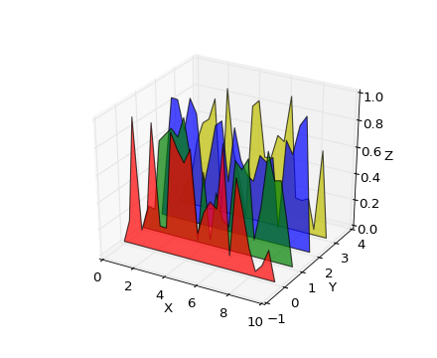
Q-Functions
Expected long-term reward as a function of the state and action under a certain policy π.
Represents the quality of an action in a particular state.
Source: https://matplotlib.org/1.3.0/mpl_examples
/mplot3d/polys3d_demo.png

Slide 12
RL Algorithms
Deep Q-Network (DQN)
Stochastic Policy Gradients (PG)
Deep Deterministic Policy Gradients (DDPG)

Slide 13
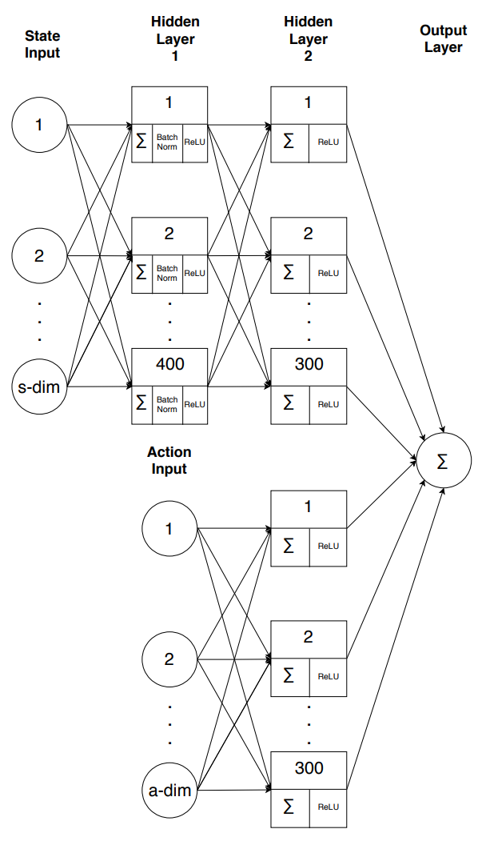
Deep Q-Network (DQN)
Model-free, off-policy method published by Mnih et al. in “Human-level control through deep reinforcement learning”.
Can determine Q for continuous state/action spaces.
Notes:
Uses ANN to estimate Q-function

Slide 14
Experience Replay Buffer
Records transitions.
Randomly sampled mini-batches remove time correlation.
Experience reuse.
Notes:
For example, using a 64 transition mini-batch, the network randomly samples 64 transitions from the experience replay buffer and trains the network Q with 64 iterations as in 6.7. After, the target network Qˆ clones the weights θi from Q and the process repeats.

Slide 15
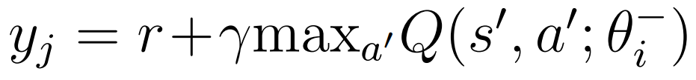
Target Network
Identical but separate Q-network.
Time delay between Q-network weight updates and policy change reduces policy instability.
Target Q-value based on Bellman Equation:
Notes:
Target network used to produce target Q values for the Bellman update equation.
Usefulness comes from being able to estimate Q for continuous states and actions.

Slide 16
RL Algorithms
Deep Q-Network (DQN)
Policy Gradients (PG)
Deep Deterministic Policy Gradients (DDPG)

Slide 17
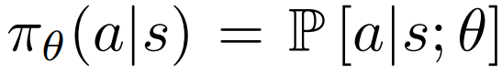
Policy Gradient Method (PG)
Find optimal policy directly without value or Q-function.
Policy produces continuous actions!
Policy implemented with a parametric probability distribution:
Notes:
Used by AlphaGo to defeat Fan Hui (2015) and Lee Sedol (2016).
Uses parametric probabilitistic distribution to choose actions directly based on their goodness.
Parametric parts means that it uses parameters or weights to adjust how likely or unlikely actions are to be taken.

Slide 18
PG Premise
Get the current state.
Stochastically choose an action from distribution P[a|s; θ].
Execute action and record the reward.
If reward is “good”, change θ to make the action more likely.
Iterate many times so actor only takes “good” actions.
Notes:
Trial and error formalized.
Important reason for policy gradients is they produce continuous actions.

Slide 19
DQN and PG Comparison
 | Deep Q-Network Method | Policy Gradient Method
Policy Action Space | Discrete | Continuous
Policy State Space | Continuous | Continuous
Q-Function Action Space | Continuous | n/a
Q-Function State Space | Continuous | n/a
Convergence Speed | Fast | Slow

Slide 20
Outline
Introduction/Motivation
Background
Solution
Implementation
Results
Future work and conclusions

Slide 21
Deep Deterministic Policy Gradient Method (DDPG)
Derived by Lillicrap et al. based on the Silver et al.’s DPG algorithm combined with learnings from Mnih et al.’s work on the DQN algorithm.
Highly flexible algorithm for continuous control.
Notes:
In Lillicrap’s paper, DDPG surpassed DPG performance in over 25 OpenAI environments without any network or hyperparameter changes. In some cases, produced a policy surpassing a planning algorithm with full access to underlying physical models and derivatives.
Published late 2015.

Slide 22
DDPG Key Features
Actor represented by ANN (PG)
Critic represented by ANN (DQN)
Experience replay (DQN)
Target networks for actor and critic (DQN)
Batch normalization
Exploration noise
Notes:
Actor and critic represented by ANNs, from DPG and DQN
Experience replay from DQN
Target networks for actor and critic from DQN. Four networks in total.
Batch normalization, allows hyperparameter generalization from Ioffe’s work
Exploration noise ensures sufficient exploration despite actor following policy

Slide 23
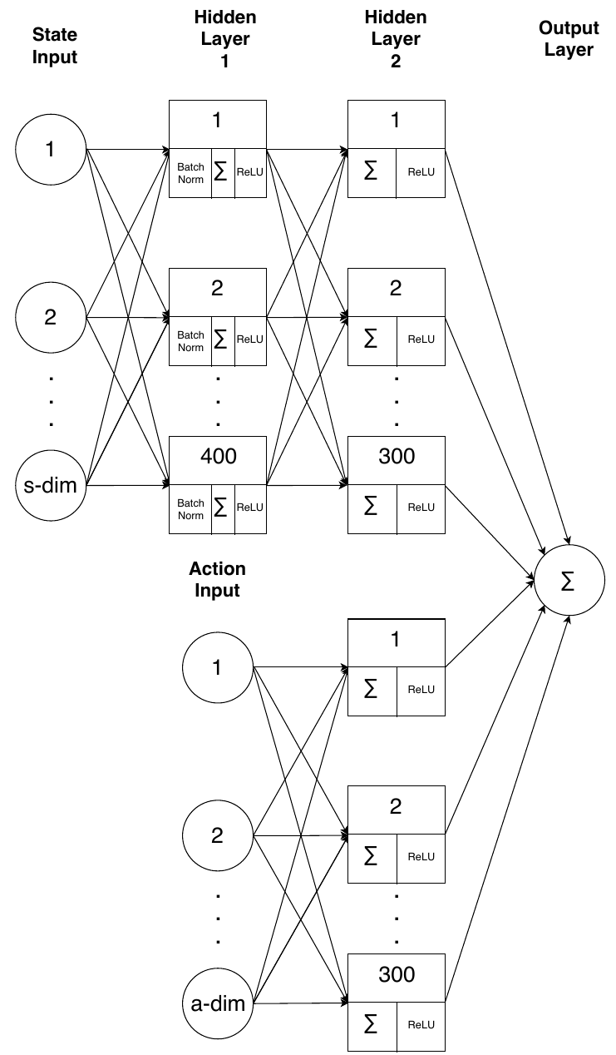
Critic Network Structure
s_dim-node state input layer
a_dim-node action input layer
Two fully connected hidden layers
HL1: 400 nodes
HL2: 600 nodes (300 for each half)
1-node output layer representing Q
Notes:
Batch normalization on state input. Rectified linear unit activation function

Slide 24
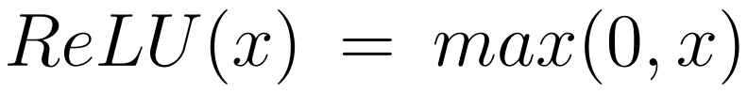
ReLU
Rectified Linear Unit activation function:
Derivative of ReLU:
1 for positive inputs
0 otherwise
Greatly speeds up forward and backward passes of network.

Slide 25
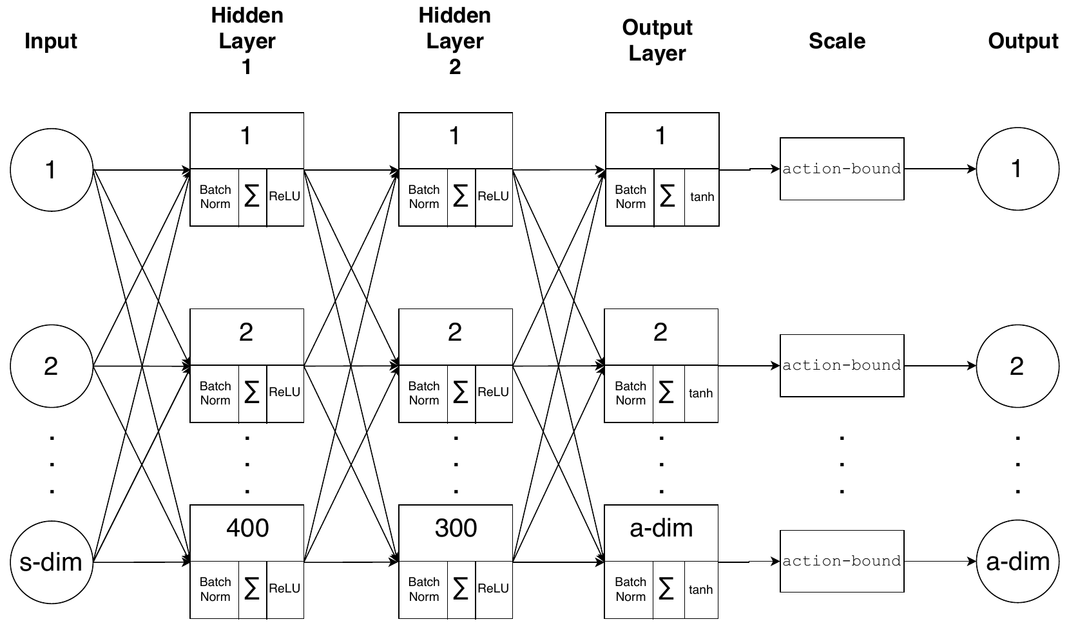
Actor Network Structure
s_dim-node input layer
Two fully connected hidden layers
HL1: 400 nodes
HL2: 300 nodes
a_dim-node output layer representing actions
Output scaling
Notes:
ReLU activations.
Tanh for output to bound. Multiply by scalar

Slide 26
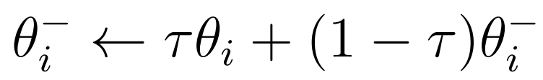
Target Networks
Duplicates of actor and critic networks.
Weights updated after each mini-batch using τ = 0.001:

Slide 27
Outline
Introduction/Motivation
Background
Solution
Implementation
Results
Future work and conclusions

Slide 28
Implementation
Python 3.6
TensorFlow for ANNs
OpenAI Gym
Pyglet

Slide 29
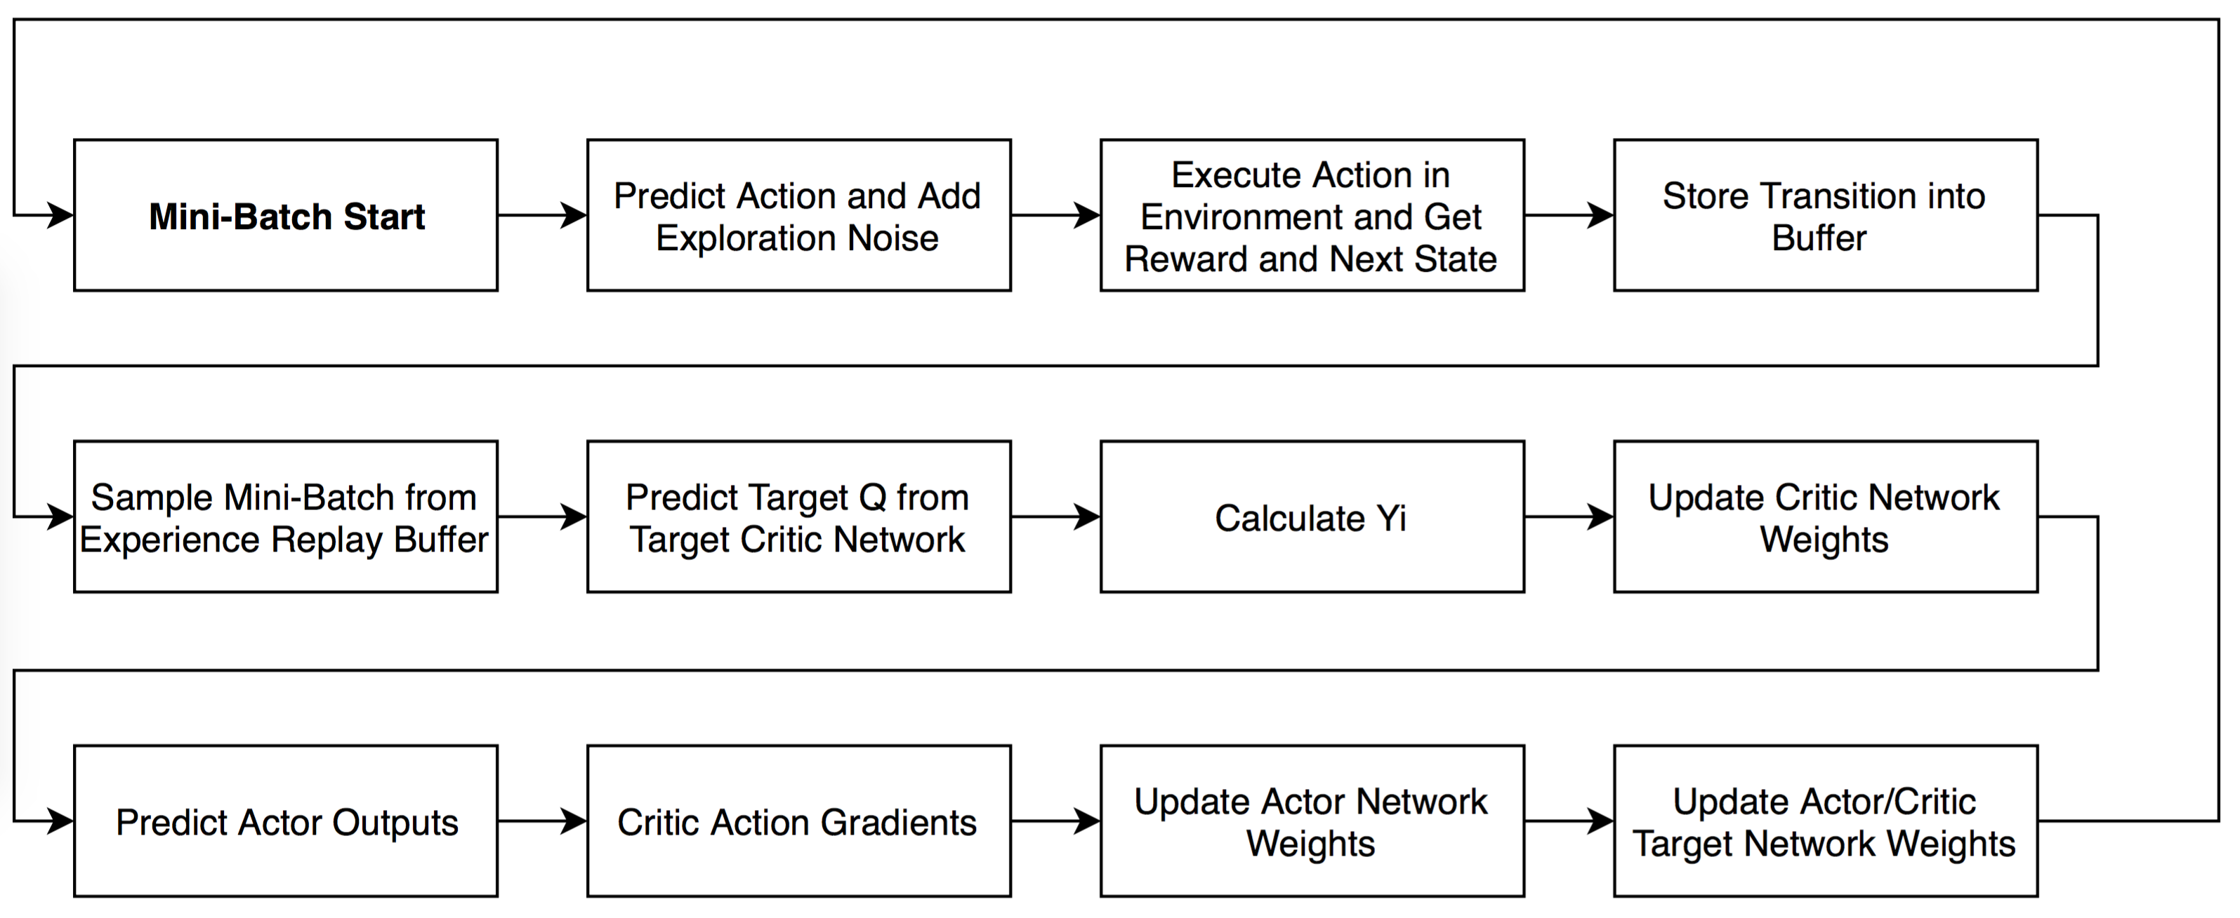
DDPG Mini-Batch Flowchart

Slide 30
Simulation
Simulates robot in the environment.
Models individual motor motion (acceleration, maximum speed, momentum).
Does not model:
Friction with ground
Varied loading on each wheel
Whole robot momentum
Small differences between motors and wheels

Slide 31
Two Approaches
Three actors
Three DDPG networks:
X translation network
Y translation network
Rotation network
Only two state inputs each:
Position (x, y, θ)
Velocity (dx/dt, dy/dt, dθ/dt)
Single Actor
One DDPG Network with three outputs for x, y, θ actions.
Uses the same inputs as the three actor variant together.

Slide 32
Two Approaches Benefits
Three actors
Faster training. 200 to 500 episodes vs. 5000 episodes.
Partial retraining possible.
Simpler troubleshooting and reward tuning.
Single Actor
Accounts for effects of actions on each other.
Only requires a single network.
Faster to process.

Slide 33
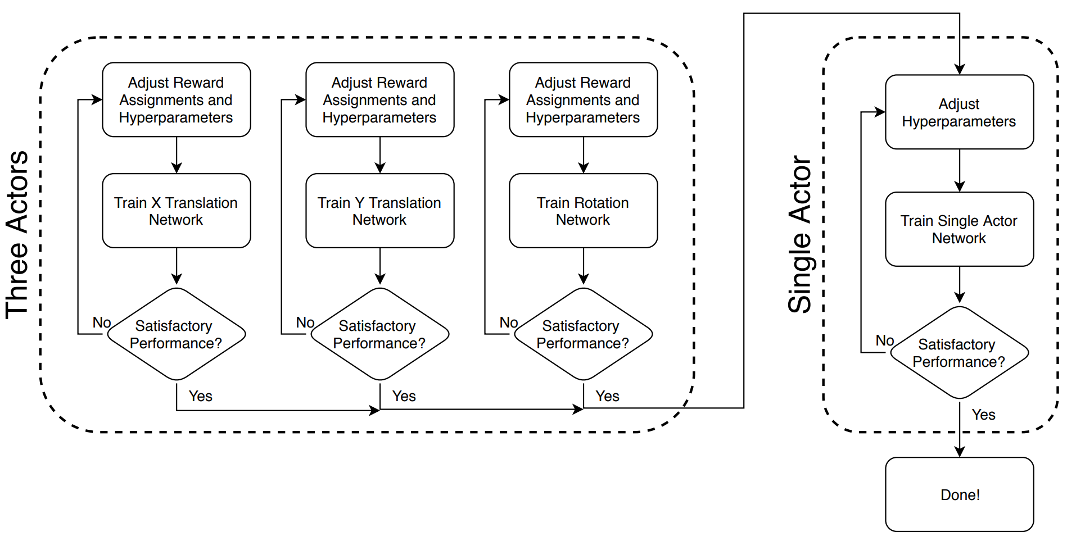
Hybrid Approach

Slide 34
Training Parameters
 | Three Actor Approach | Single Actor Approach
Episode length (s) | 10 | 10
Episode step period (s) | 0.05 | 0.05
Actor learning rate | 10⁻⁴ | 10⁻⁵
Critic learning rate | 10⁻³ | 10⁻⁴
Discount factor | 0.99 | 0.99
Target network update parameter | 10⁻³ | 10⁻⁴
Mini-batch size | 64 | 128

Slide 35
Demo
Live demo of rotation training.

Slide 36
Outline
Introduction/Motivation
Background
Solution
Implementation
Results
Future work and conclusions

Slide 37
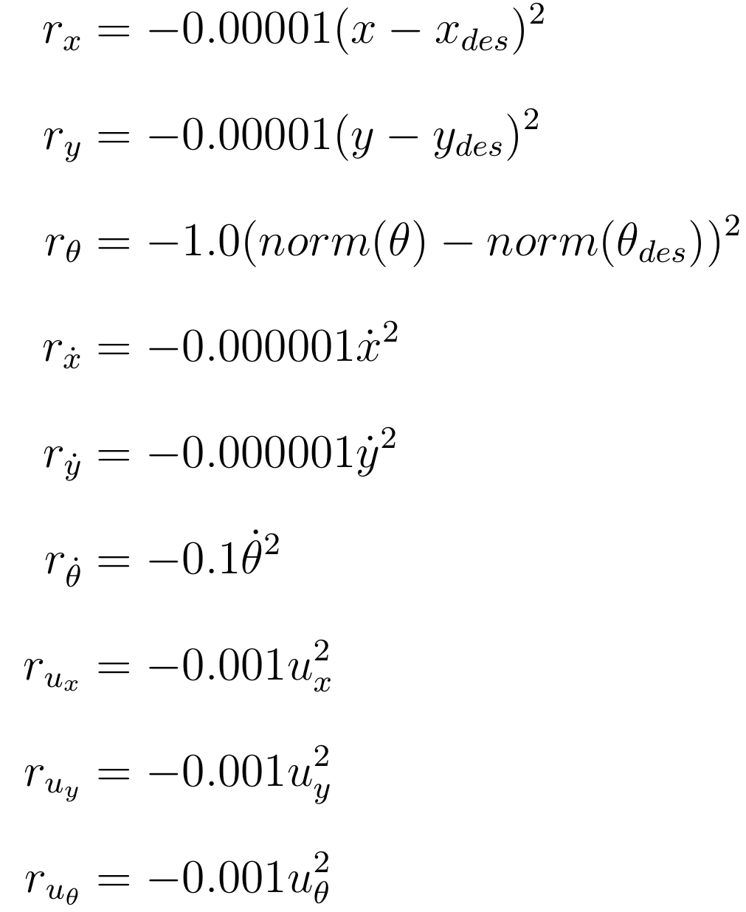
Reward Assignment
Maximum reward is 0.
Becomes more negative with:
Increased error from set point.
Larger magnitude velocity.
Larger magnitude actions.

Slide 38
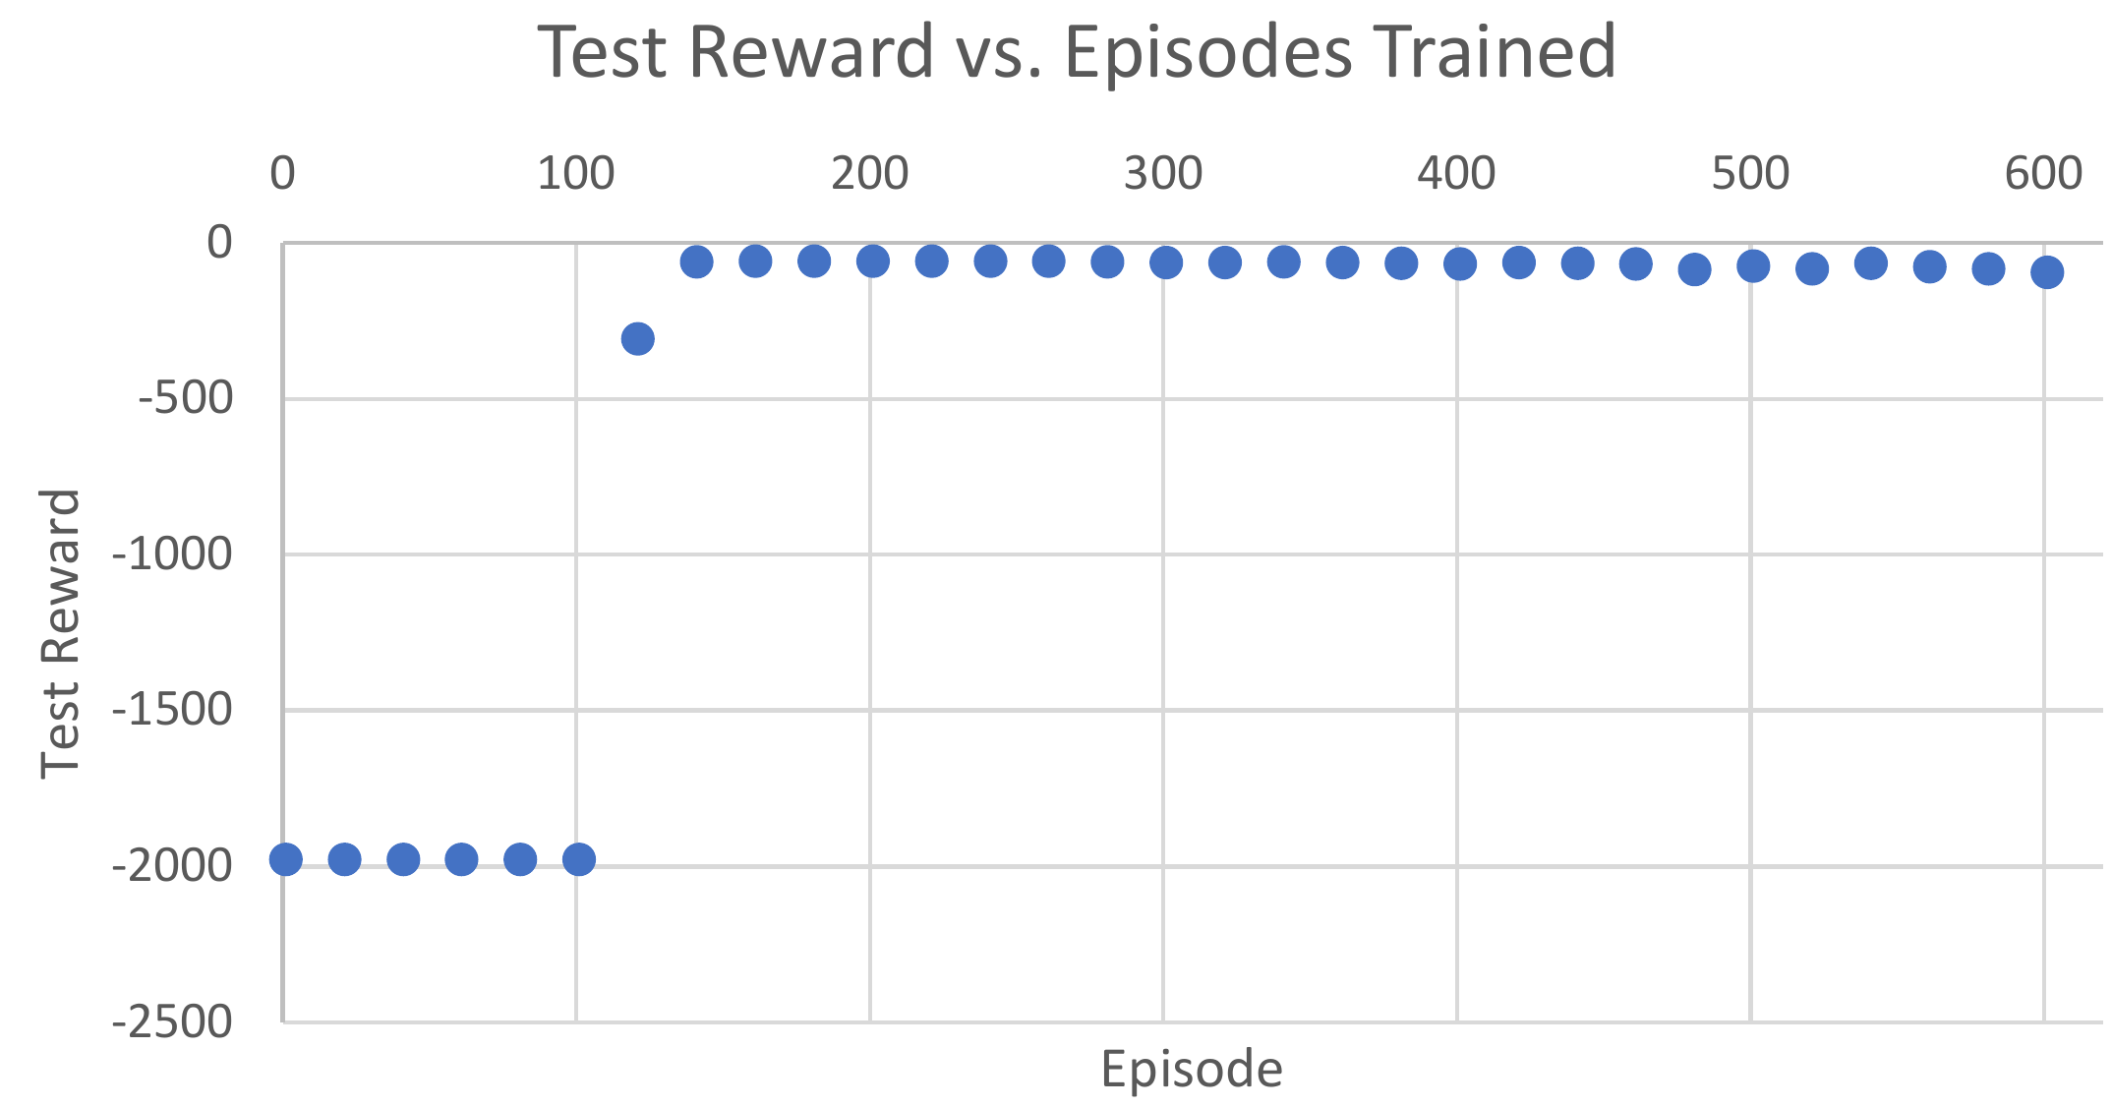
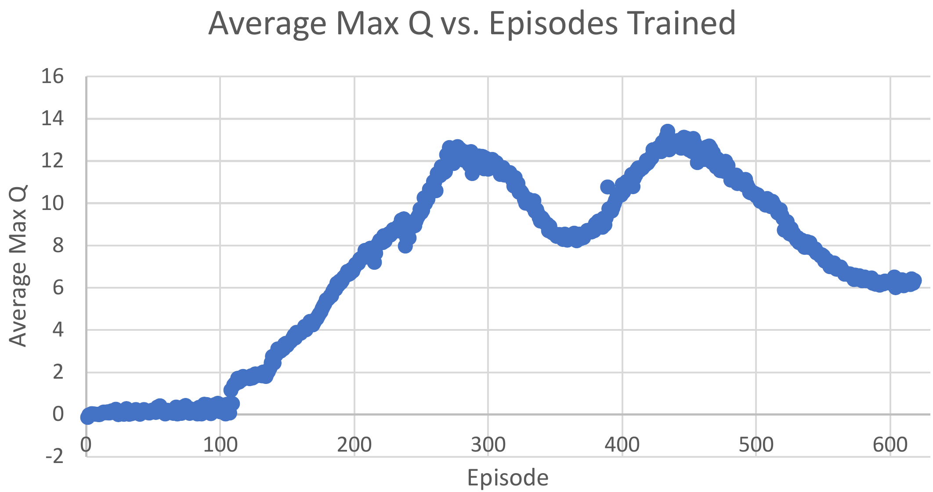
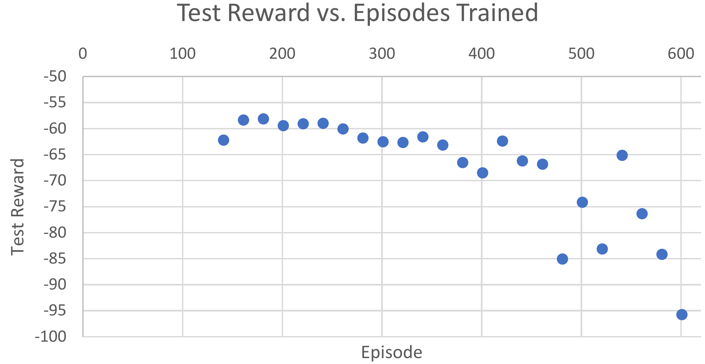
X Translation

Slide 39
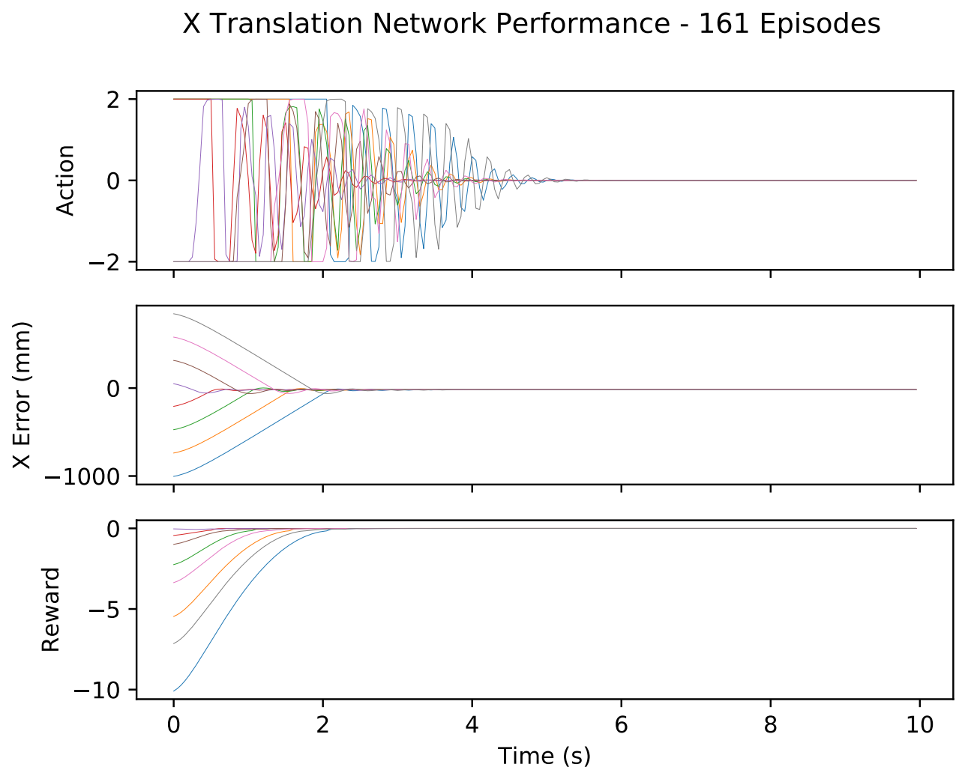
X Translation Response
Robot reaches set point.
Small overshoot.
Action decays to 0.

Slide 40
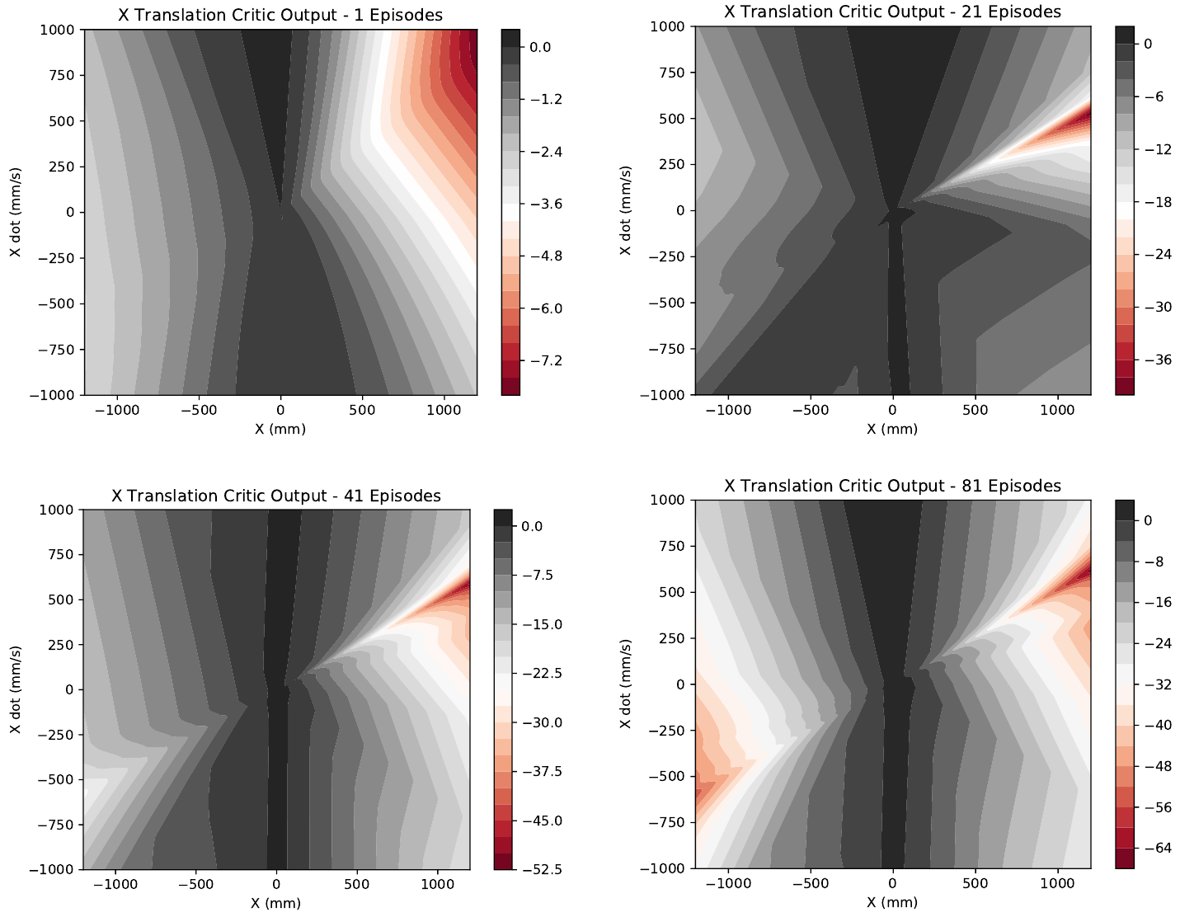
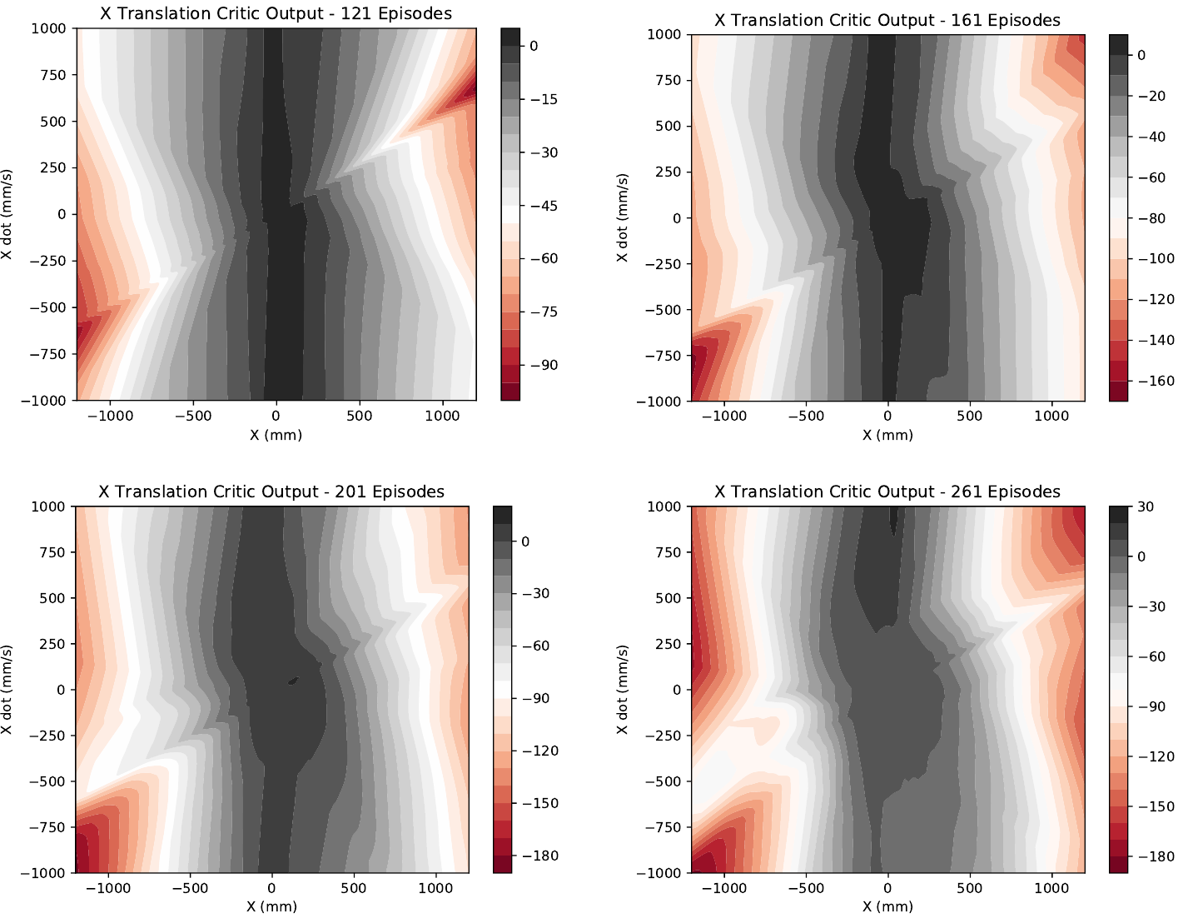
X Translation Critic Progress

Slide 41
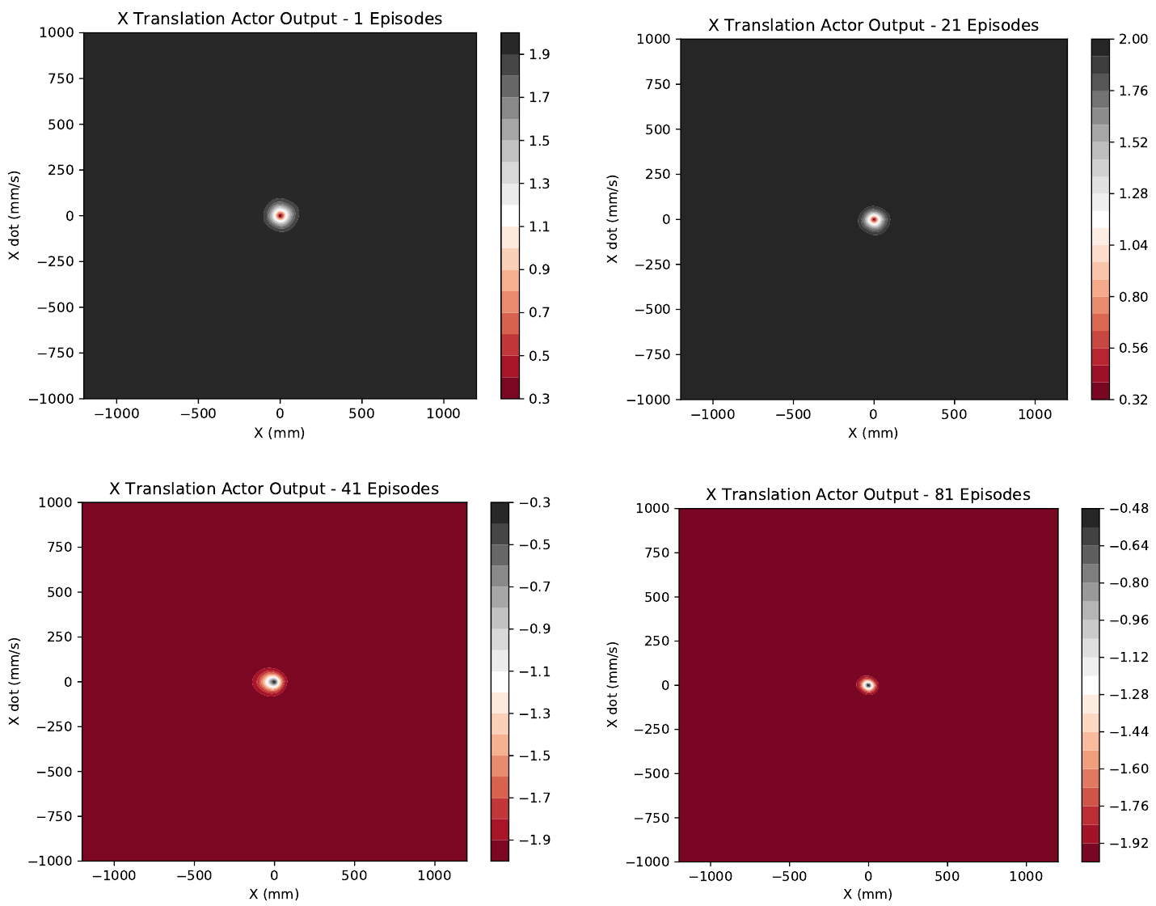
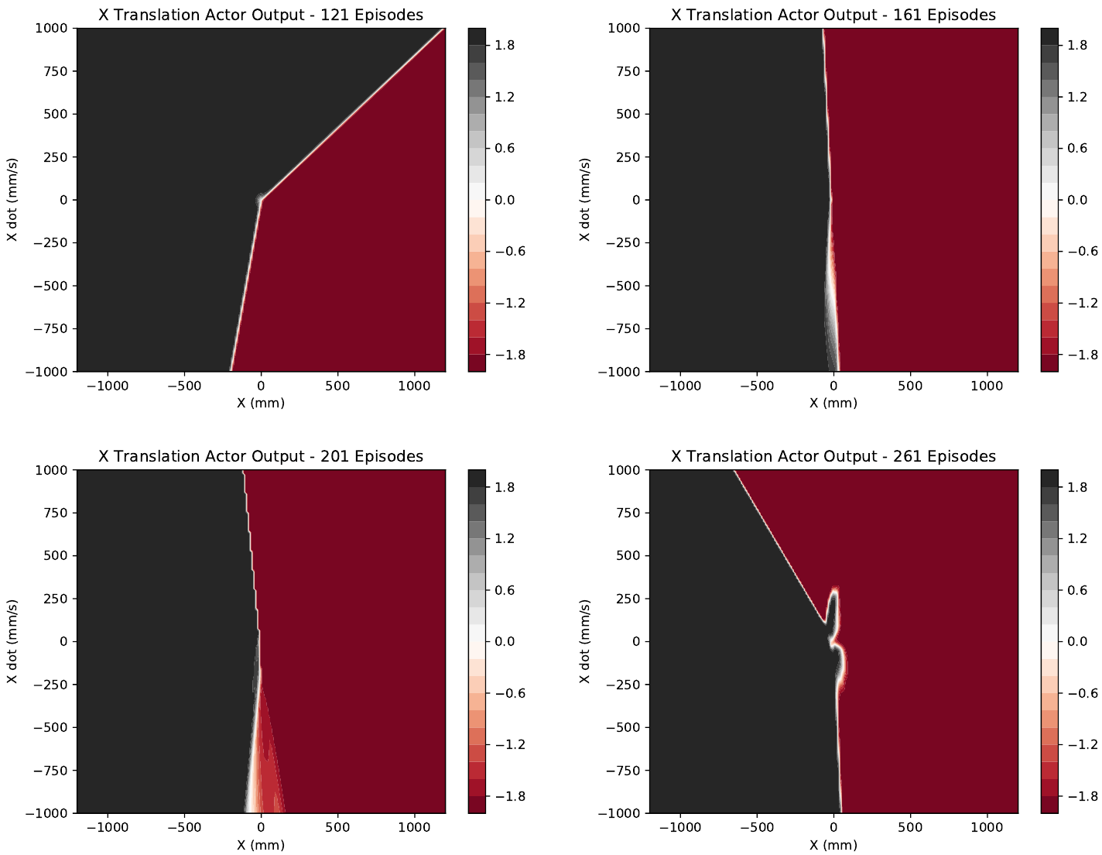
X Translation Actor Progress

Slide 42
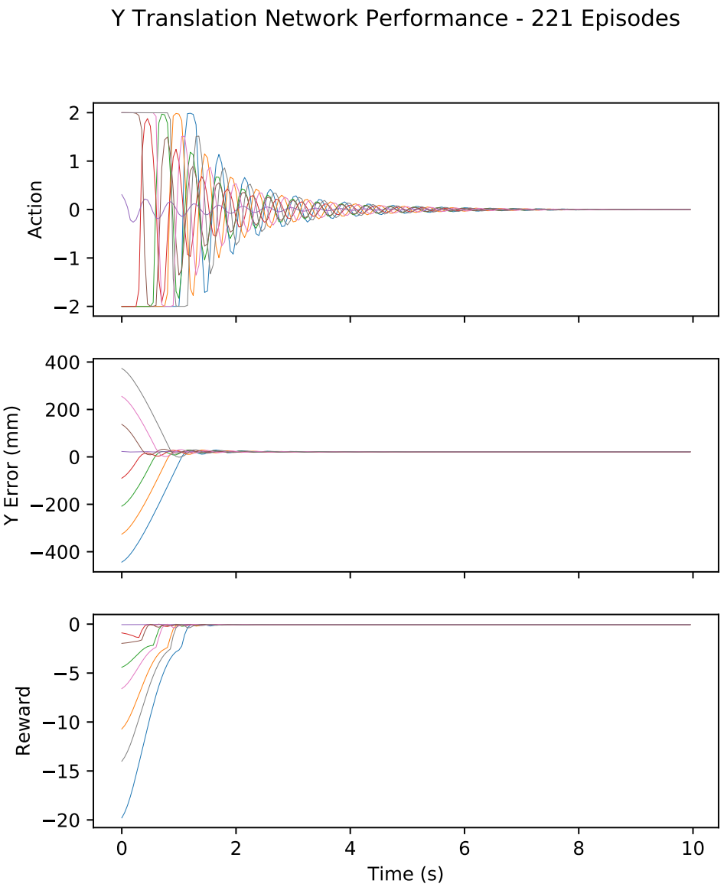
Y Translation Response
Similar to X translation results.

Slide 43
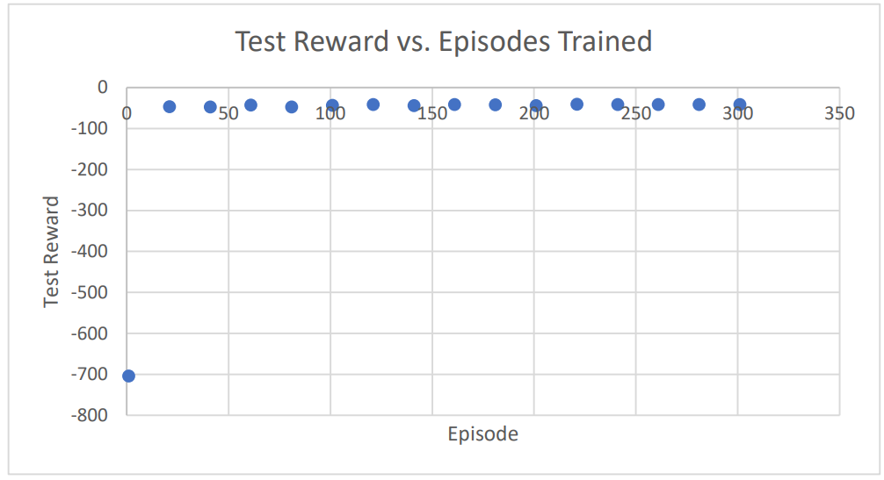
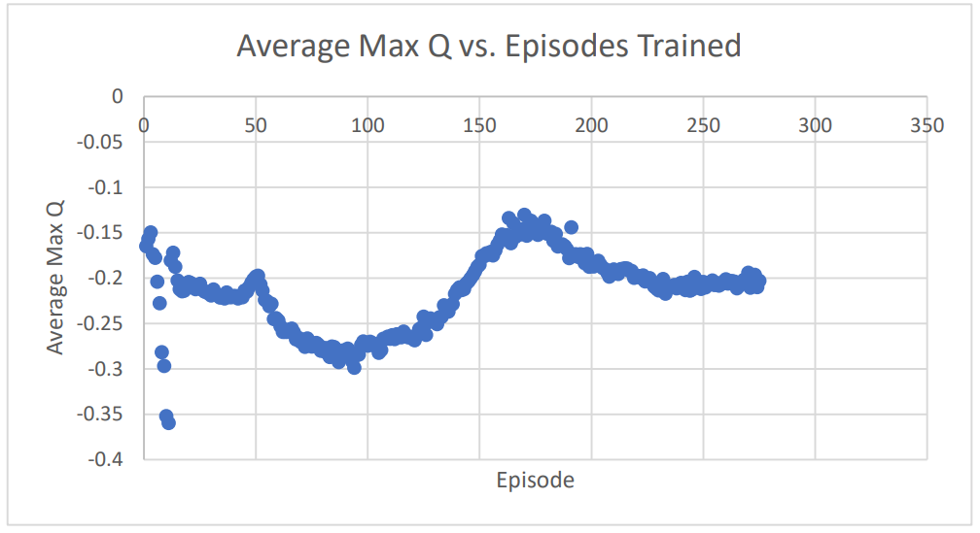
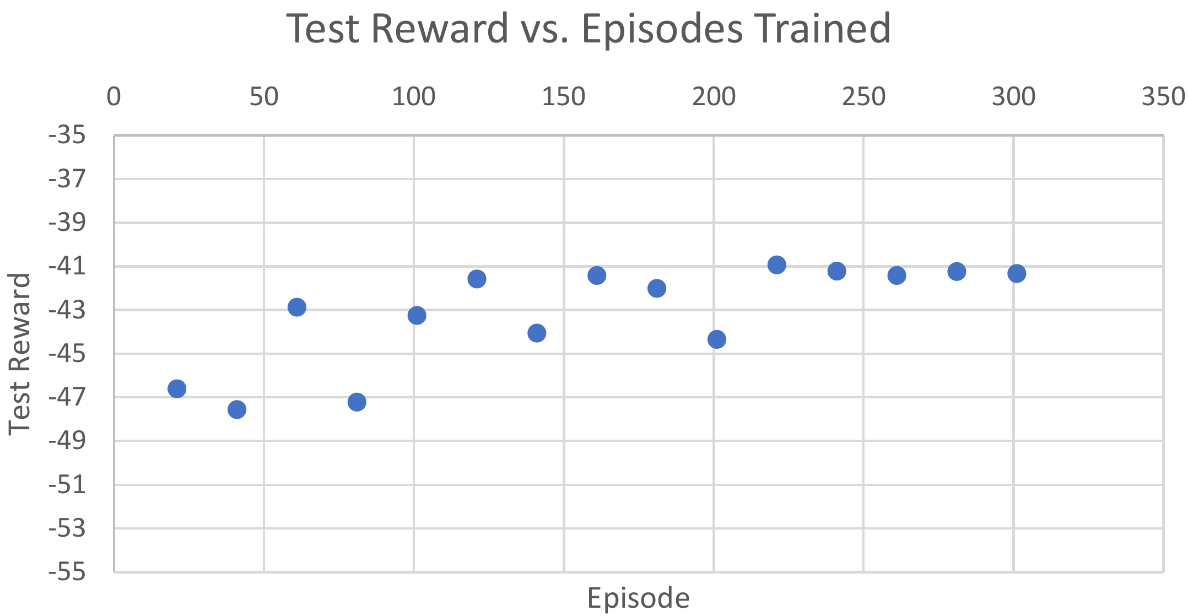
Rotation Network

Slide 44
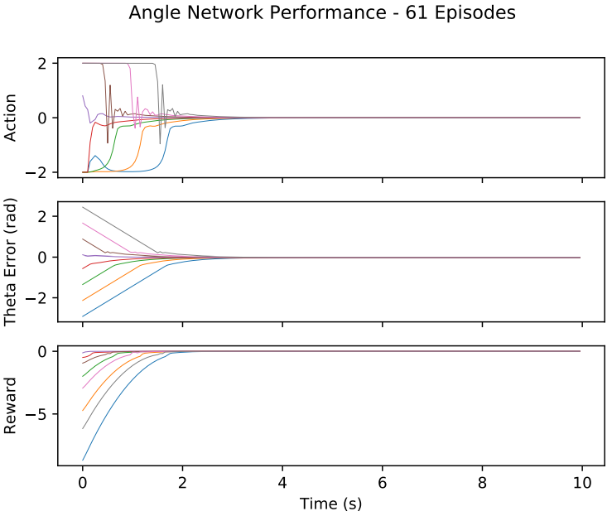
Rotation Network Response
Successfully reaches set point.
Action decays to 0.
No overshoot.

Slide 45
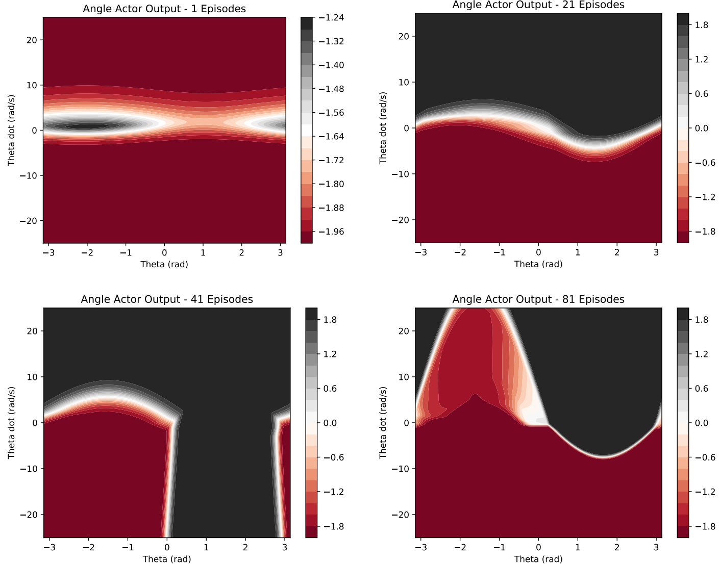
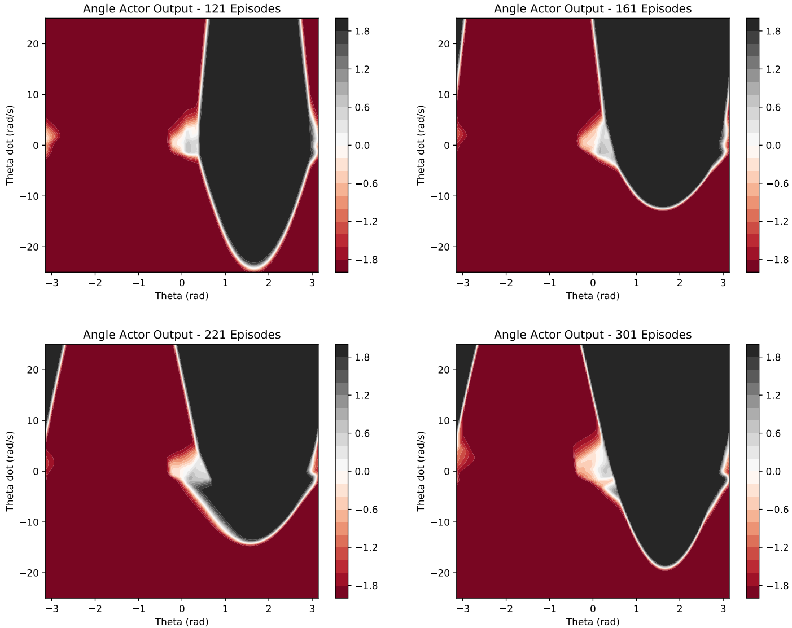
Rotation Actor Progress

Slide 46
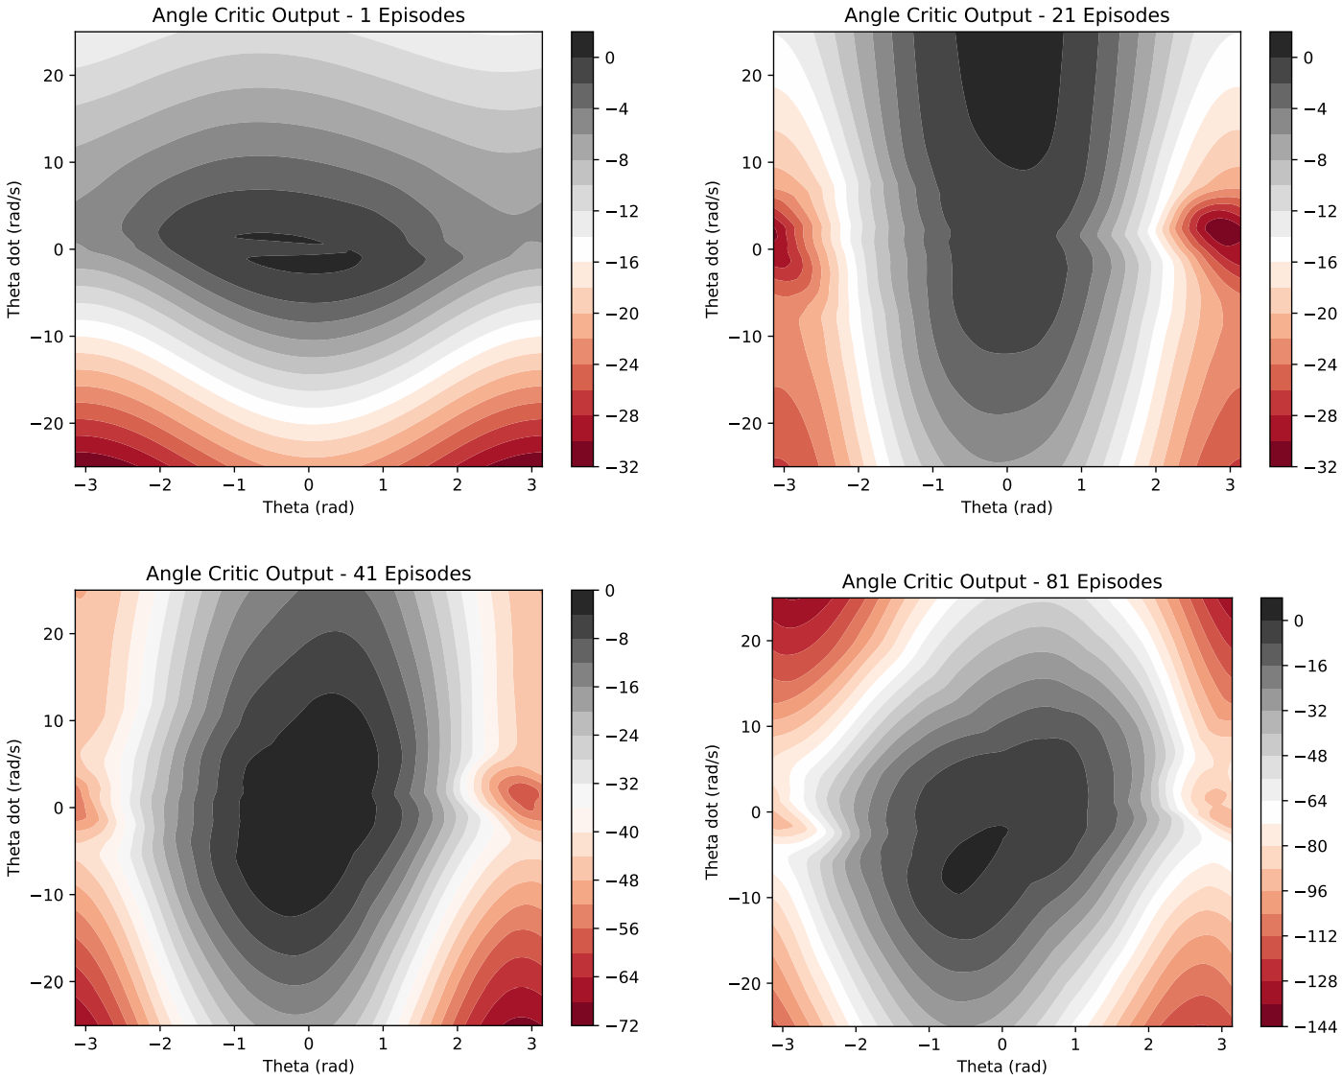
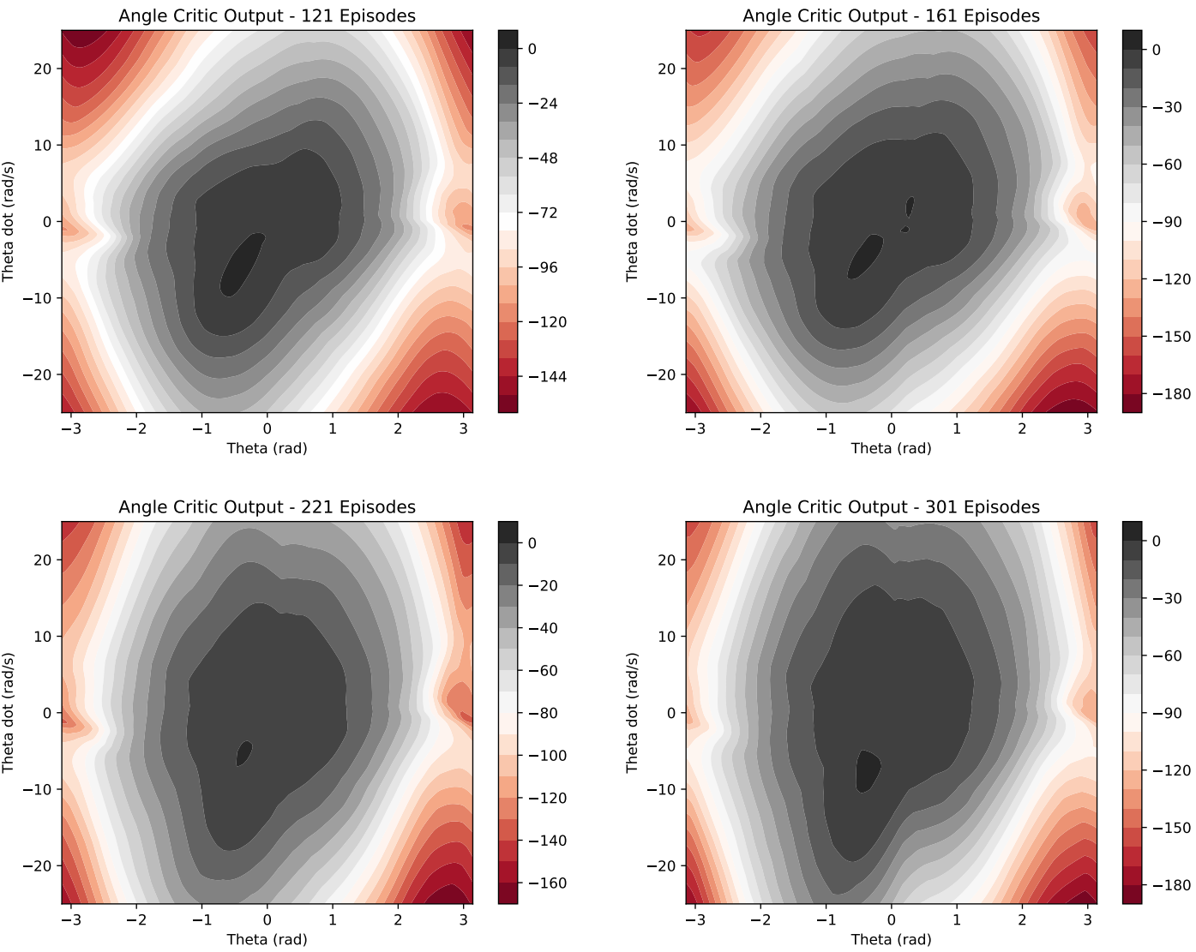
Rotation Critic Progress

Slide 47
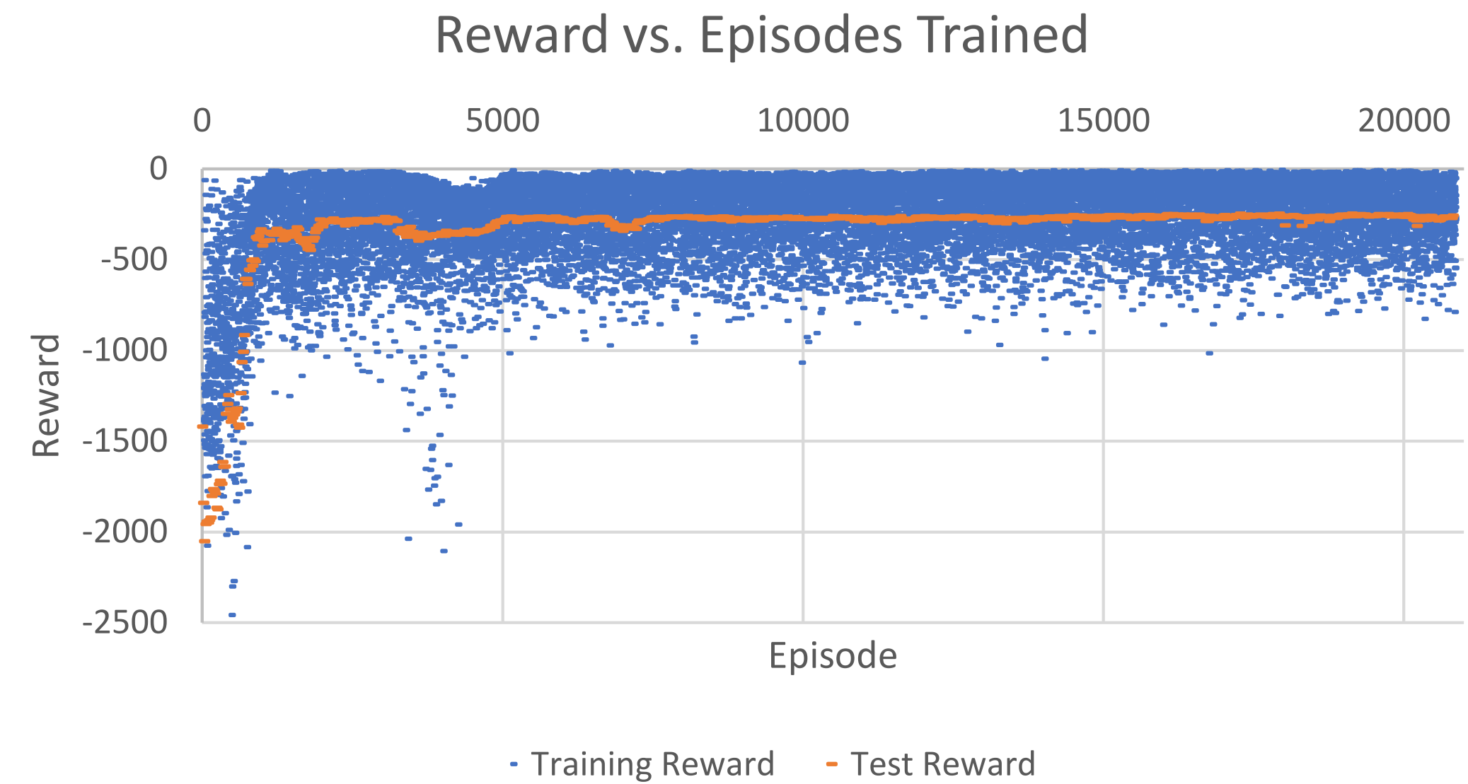
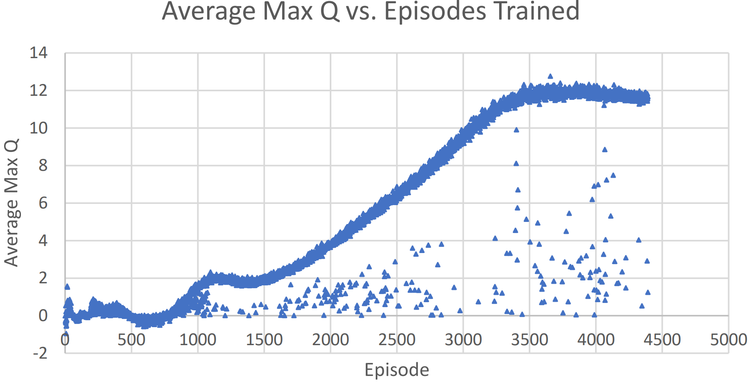
Full Control Network Results

Slide 48
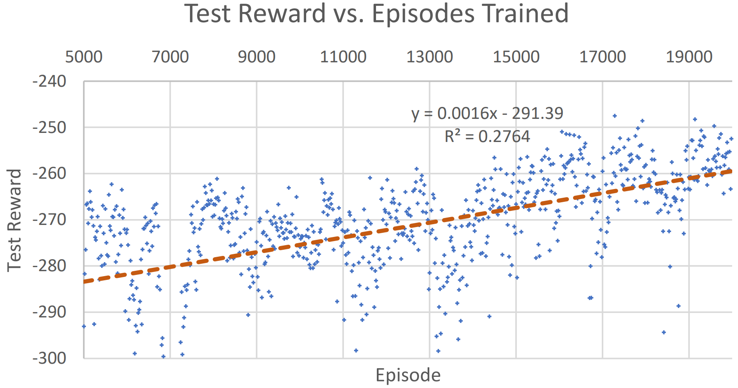
Full Control Network Test Reward Close-Up

Slide 49
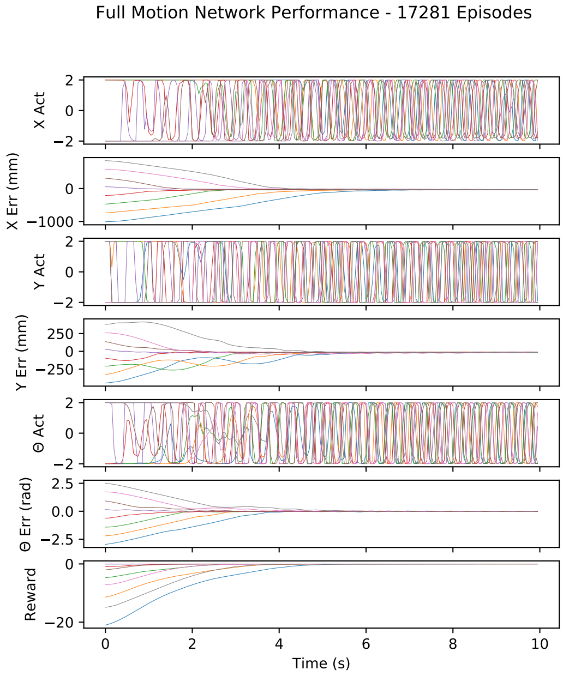
Full Control Network Response
Reaches -276.5 reward by episode 5,041.
Maximum reward of -247.5 at episode 17,281.
Notes:
Progress from 1 to 21,201 episodes.

Slide 50
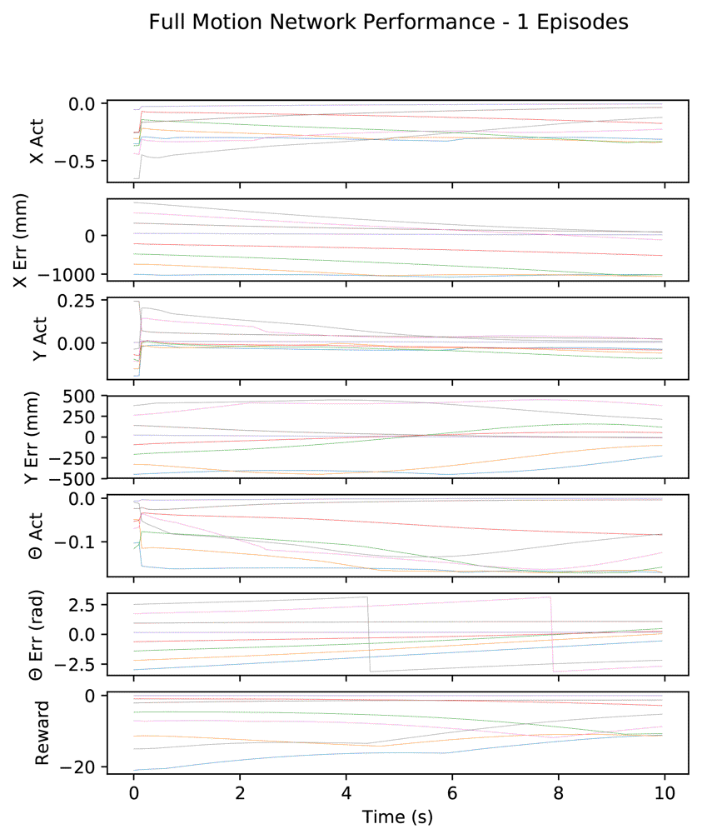
Full Control Network Response
Reaches -276.5 reward by episode 5,041.
Maximum reward of -247.5 at episode 17,281.
Notes:
Progress from 1 to 21,201 episodes.

Slide 51
Two Approach Comparison
Three Actors
Single Actor

Slide 52
Outline
Introduction/Motivation
Background
Solution
Implementation
Results
Future work and conclusions

Slide 53
Conclusion
DDPG effectively solves continuous control of the robot.
Where possible, dividing the system by orthogonal controls allows focused training.
Reliant on reward assignment to achieve desired result.
Notes:
Where possible, dividing the system by orthogonal controls allows focused training:
Improves convergence.
Reduces training time.
Can retrain individual networks without affecting others.
Small changes in reward assignment weights changed training outcome.

Slide 54
Future Work
More experimentation with reward assignments.
Algorithm for automatic reward scaling.
Additional model parameters.
More training with robot instead of simulation.

